Slide 1
Introduction to Swarm Robotics¹
Samuel Jackson (slj11)
1. Navarro, Iñaki, and Fernando Matía. "An introduction to swarm robotics." ISRN Robotics 2013 (2012).

Slide 2
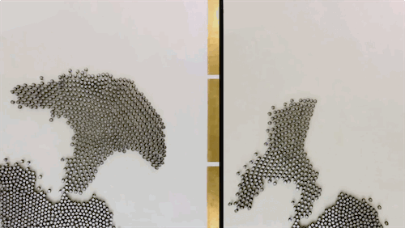
What is Swarm Robotics?
Large groups of robots (large is relative of course!)
How can we coordinate them?
Only using local rules
Produce complex global behaviour
Kilobot robots developed at Harvard
https://goo.gl/iGtG9d

Slide 3
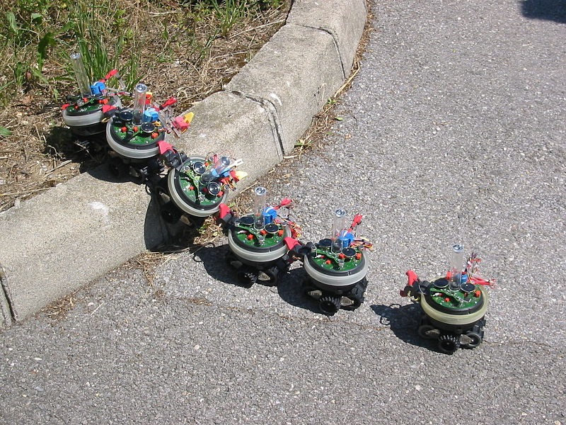
Why Swarm Robotics?
Performance
Task enablement
Distributed
Sensing & Actions
Fault tolerance
Environments
Dangerous & remote
S-Bot performing a climbing task
Image Source: Francesco Mondada and Michael Bonani.
https://goo.gl/8whVcX

Slide 4
Behaviours

Slide 5
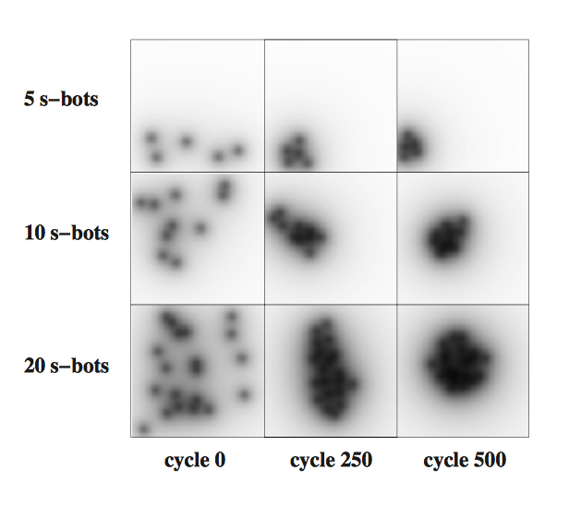
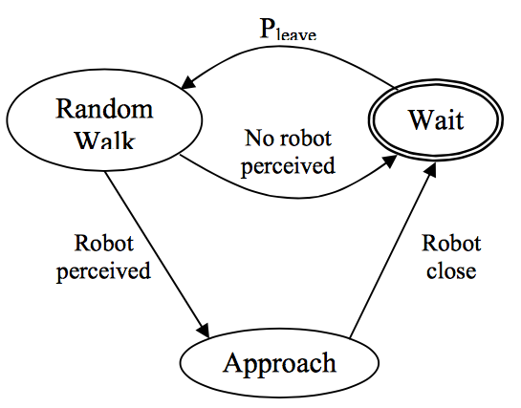
Aggregation
How do robots find each other?
Methods
Evolutionary Algorithms
Potential Functions
Probabilistic FSM
(Left) Evolving clusters of robots.
Trianni et al.¹
(Right) Probabilistic FSM
Soysal and Sahin²
Trianni, Vito, et al. "Evolving aggregation behaviors in a swarm of robots." Advances in artificial life. Springer Berlin Heidelberg, 2003. 865-874.
Soysal, Onur, and Erol Şahin. "A macroscopic model for self-organized aggregation in swarm robotic systems." Swarm robotics. Springer Berlin Heidelberg, 2006. 27-42.

Slide 6
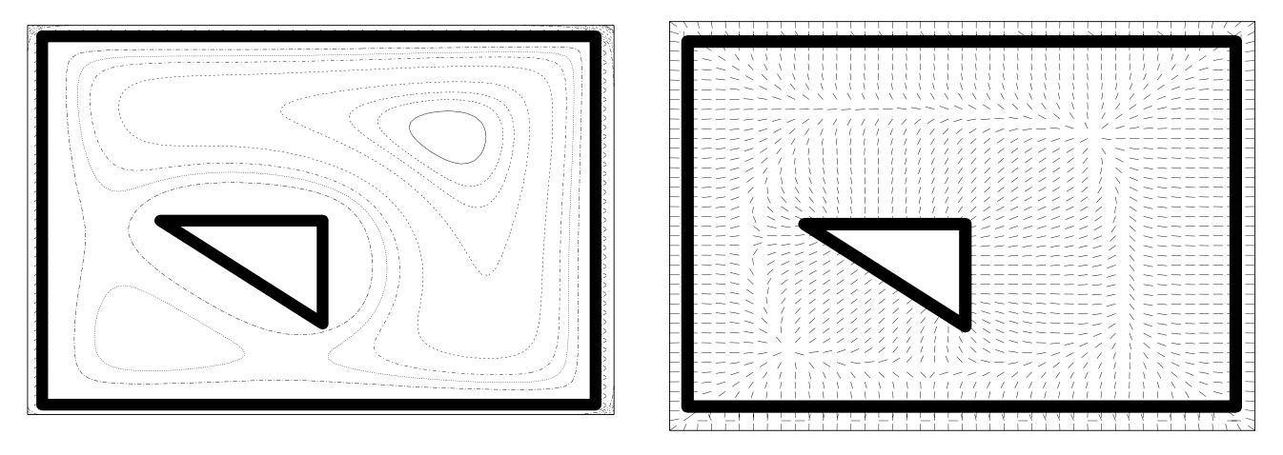
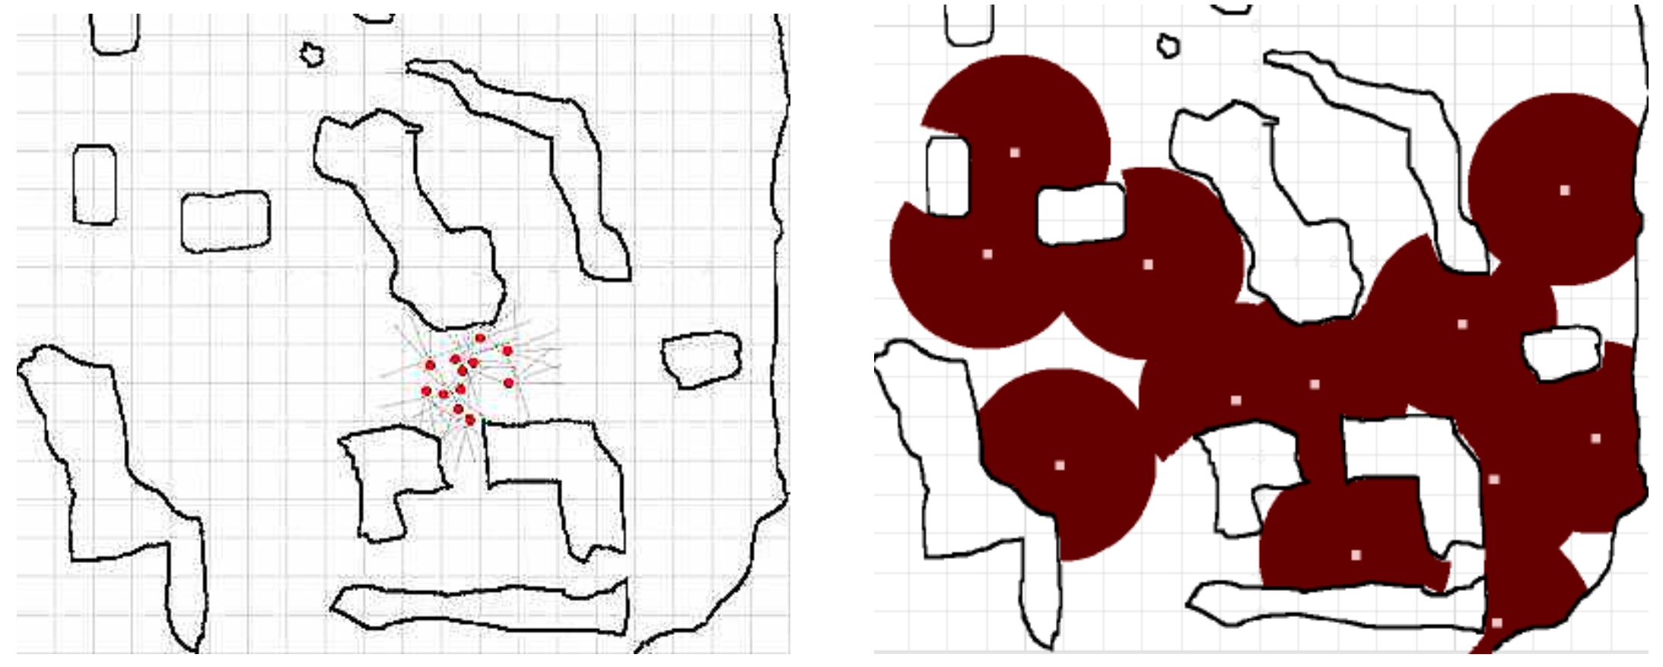
Dispersion
Efficiently distribute in environment
Methods
Potential Fields
Wireless Signal Intensity
Potential fields. Walls exhibit repulsive forces.
Andrew et al.¹
Wireless signals repel according to the inverse square law.
Damer et al.²
Howard, Andrew, et al. "Mobile sensor network deployment using potential fields: A distributed, scalable solution to the area coverage problem." 2002.
Damer, Steven, et al. "Dispersion and exploration algorithms for robots in unknown environments." 2006.

Slide 7
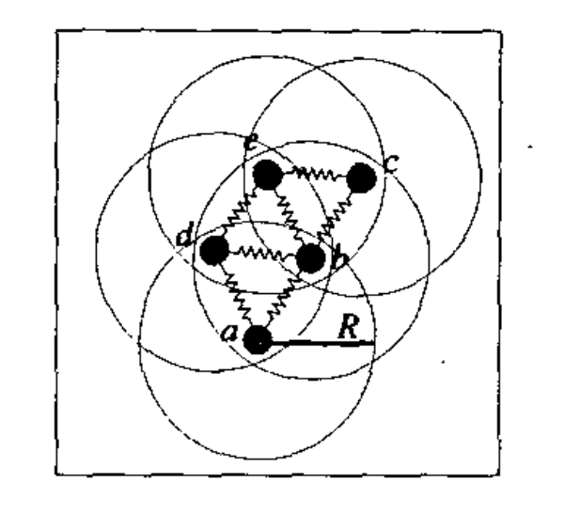
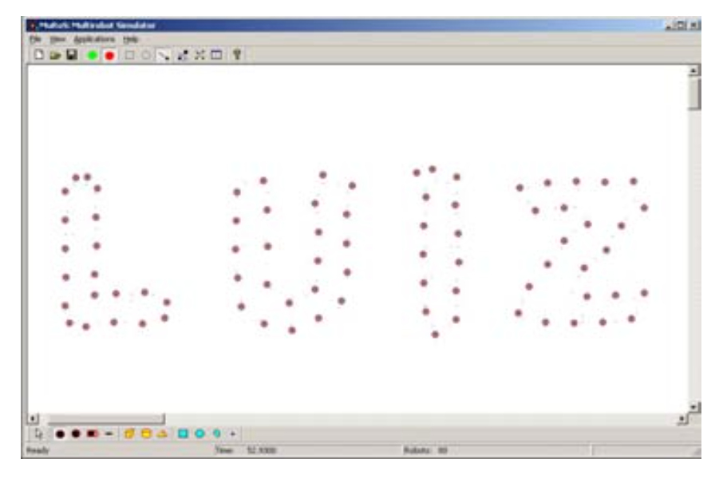
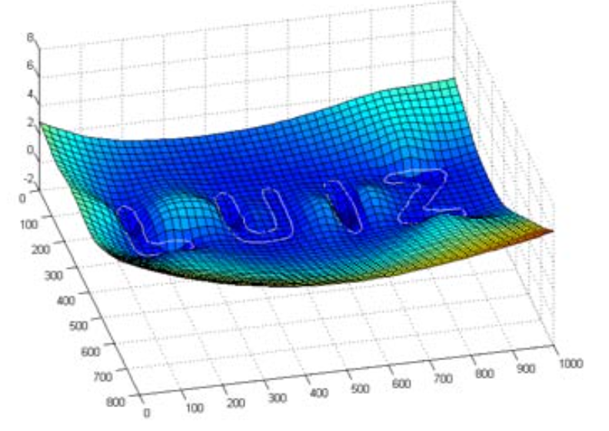
Pattern Formation
Creating global shapes by changing the positions of individual robots.
Methods
Virtual Springs
Implicit Functions
(Right) Virtual springs push a pull robots into position.
Fujibayashi et al.¹
(Left, Middle) Implicit functions find zero isocontour.
Chaimowicz et al.²
Fujibayashi, Kenichi, et al. "Self-organizing formation algorithm for active elements.” 2002.
Chaimowicz, Luiz, Nathan Michael, and Vijay Kumar. "Controlling swarms of robots using interpolated implicit functions." 2005.

Slide 8
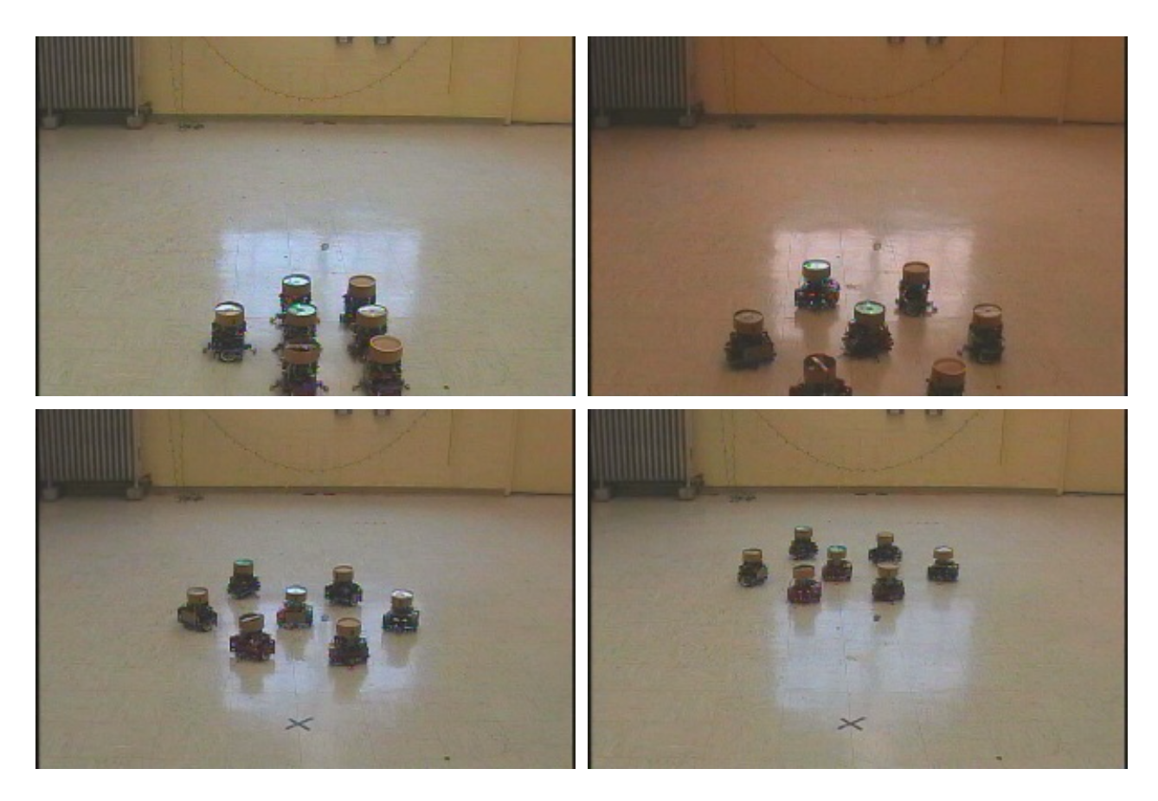
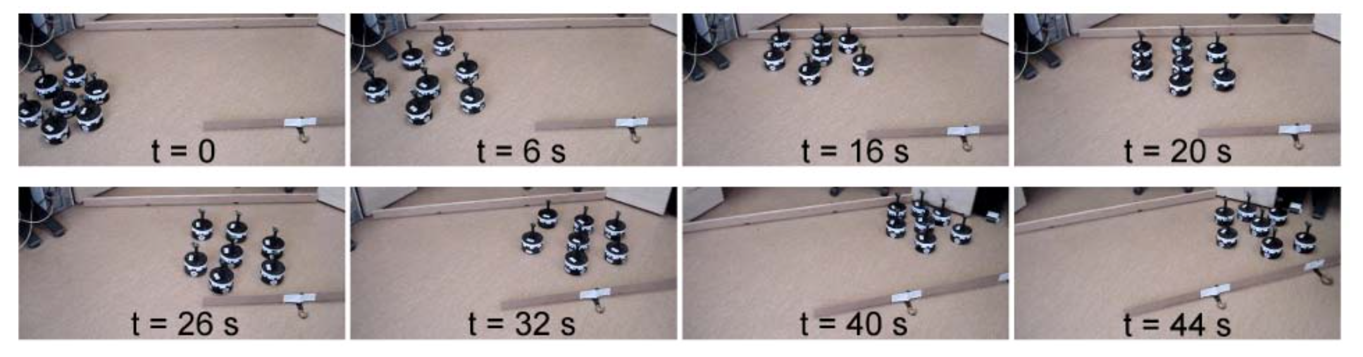
Movement
How to coordinate robots and move them as a group
Methods
Physicomimetrics
Flocking
(Top) In Physicomimetrics robots minimise the potential energy of the system.
Spears et al.¹
(Right) Flocking using order, entropy, and velocity measures. Using Kobot robots.
Spears et al.¹
Spears, William M., Diana F. Spears, and Rodney Heil. "A formal analysis of potential energy in a multi-agent system." 2004.
Turgut, Ali E., et al. "Self-organized flocking in mobile robot swarms." 2008.

Slide 9
Tasks

Slide 10
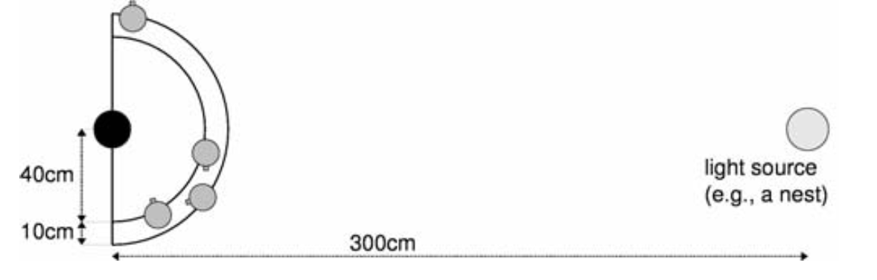
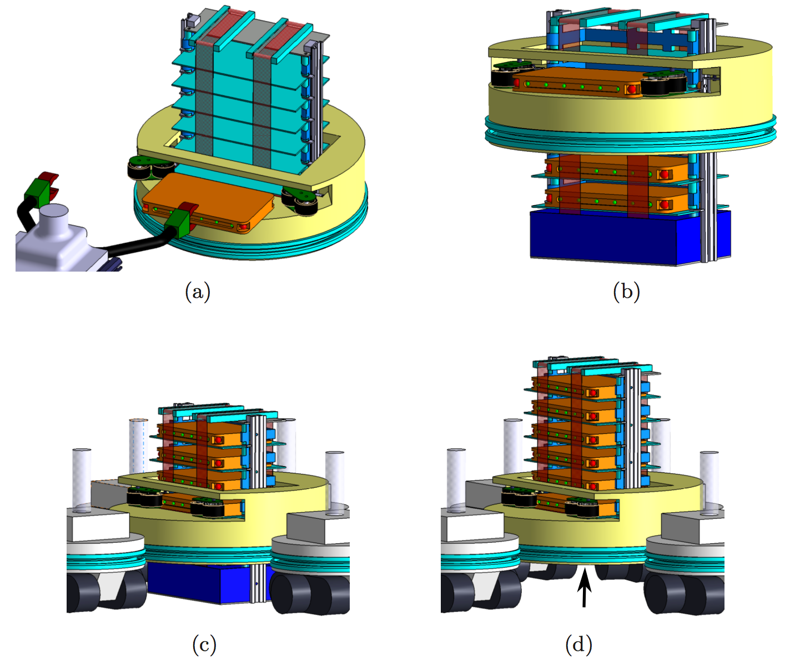
Transport
Moving objects using more than one robot
Methods
Evolutionary Box Pushing
Collective transport²
(Top) Evolutionary approach uses a recurrent NN to push an object to a source.
Gross and Dorigo¹
Gross, Roderich, and Marco Dorigo. "Towards group transport by swarms of robots." 2009
Decugniere, Antoine, et al. "Enhancing the cooperative transport of multiple objects." 2008

Slide 11
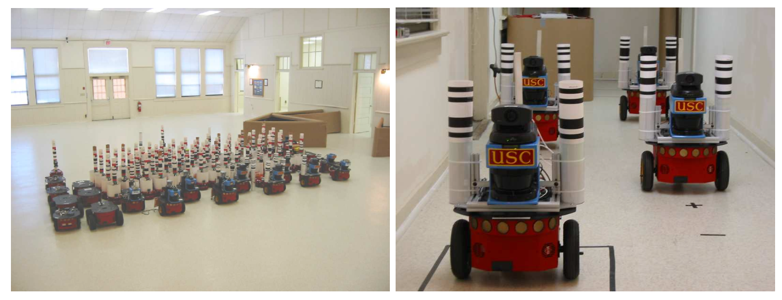
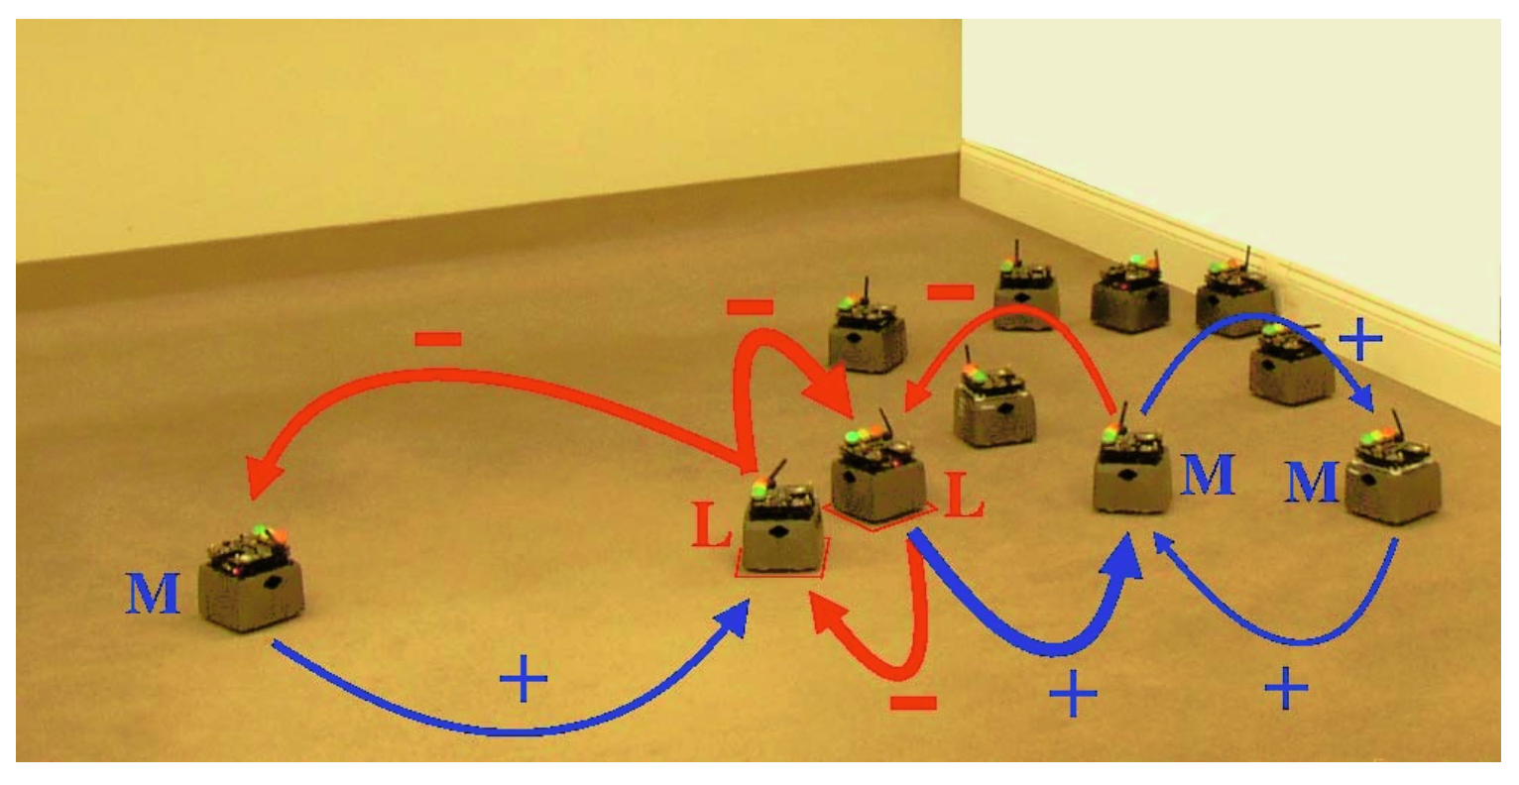
Mapping
Mapping an environment using multiple robots
Methods
SLAM with swarm
Landmarks
(Top) Heterogenous groups of Pioneers map an environment and merge maps.
Howard et al.¹
(Left) Swarmbot “Landmarks” and “movers” compete with one another to map.
Decugniere et al.²
Howard, Andrew, Lynne E. Parker, and Gaurav S. Sukhatme. "The SDR experience: Experiments with a large-scale heterogeneous mobile robot team." 2006.
Decugniere, Antoine, et al. "Enhancing the cooperative transport of multiple objects." 2008

Slide 12
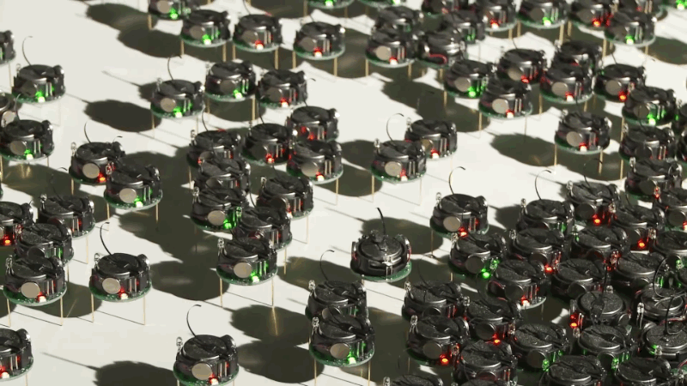
Research Challenges
Algorithm Design & Scalability
Implementation & Testing Frameworks
Analysis & Modelling
Security Concerns
Kilobot robots developed at Harvard
https://goo.gl/iGtG9d

Slide 13
Final Thoughts
Not as impressed by this paper
Slightly skeptical of the publishing company
Failed to give me a “taste of the methods”
Some parts were not well written (sec. 4, para 1)
I had to look elsewhere!

Slide 14
Thank you
Any Questions?

